Slide 1
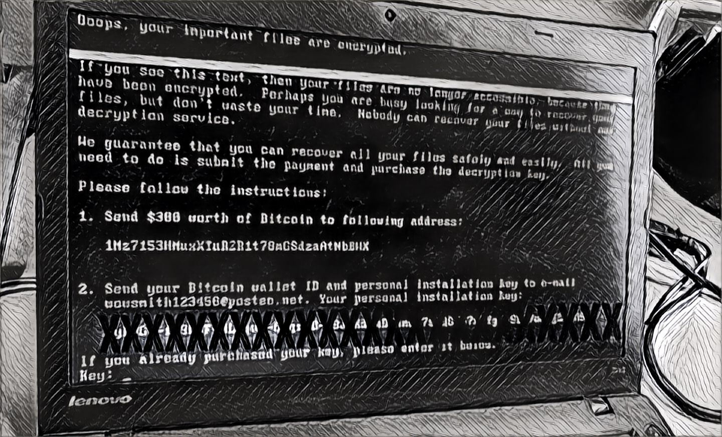
Accidental Anarchy: the NotPetya Attack
What Executives & boards can learn from this 2017 incident

Slide 2

About Me
Paul Roberts
Technology reporter, editor and industry analyst
15+ years covering information security
Contributor: Christian Science Monitor, Economist, CIO/CSO, Economist Intelligence Unit, MIT Tech Review, Infoworld, Threatpost, etc.
Analyst: 451 Group
Security Ledger
Founded in 2012
An independent voice in information security
Pioneering coverage of:
Internet of Things and security
Threats to critical infrastructure
Connected vehicles
Healthcare cyber security
Cybersecurity policy
Blog, podcast, in-person & online events

Slide 3
Shameless promotion…
If you like what you hear, subscribe to Security Ledger’s Weekly Ledger.
Executive-focused email newsletter rounding up the top cyber security stories of the week.
Text the word security to the number 345345 to join.

Slide 4
Background: NotPetya
First appeared June 27, 2017
Destructive “wiper” malware that looks/acts like “ransomware”
Wipers don’t just encrypt data – they destroy it
Based on known ransomware dubbed “Petya” (Russian)
Believed to be nation-state backed operation
Primary target: Govt. of Ukraine and Ukraine civil society

Slide 5
Background: NotPetya
Initially spread as a software update for M.E.Docs, Ukrainian Accounting software package
Distributed as signed software updates from compromised firm
Destructive “wiper” malware designed to look/act like ransomware
Based on known malicious software dubbed “Petya” with Russian origins – but probably created by a separate group
Believed to be nation-state backed operation
Primary target: Ukraine
Notes:
Many of these campaigns appeared to imitate ransomware on the surface. However, the true intent of these operations was not financial gain, as is typically the case with ransomware — it was to destroy data on targeted networks.
The XData campaign, for example, did not provide a payment amount or guidance on how file recovery could occur.
The operators of NotPetya initially offered an email to facilitate payment, but this address was suspended shortly after news of the malware broke. A truly financially motivated actor likely would not have implemented such a fragile payment mechanism,
Conclusion:
The motivation for the actor behind NotPetya was not financial gain, but rather data destruction. Moreover, the developers of NotPetya altered Petya ransomware to erase the decryption key after encrypting the master file table (MFT). This technique offers no method to recover the files, making NotPetya a wiper, not ransomware.
The NotPetya developers altered the Petya binary, suggesting the adversary did not have access to the source code, and therefore, reverse-engineered the malware. This also reaffirms the assessment that NotPetya and Petya were created by separate developers.

Slide 6
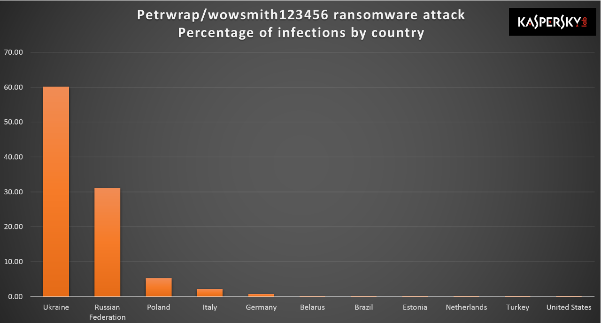
NotPetya Infections by Country
Infected more than 1 million computers
2,000 companies in Ukraine hit by NotPetya
Extensive “spill over” outside Ukraine including Russia, Poland, Italy, Germany
FedEx, Maersk, Merck & Mondelez all heavily impacted

Slide 7
Why this matters (part 1)
Part of long running tensions between Russia and Ukraine
Extensive use of cyber operations to disrupt Ukrainian government and civil society
Companies were not targets of campaign or actors, but innocent bystanders of regional tension between Russia and Ukraine

Slide 8
Маскировка (maskirovka)
a Russian military doctrine developed from the start of the twentieth century. The doctrine covers a broad range of measures for military deception, from camouflage to denial and deception.

Slide 9
Why this matters (part 2)
Massively costly to affected firms
$400 million in direct, indirect costs at FedEx (and counting)
$184m for Mondelez with $84m in direct costs and ~$100 million in lost revenue
Merck left unable to produce GARDASIL vaccine prompting emergency borrowing from US Govt. stockpile

Slide 10
Why this matters (part 3)
Affected companies were hit because:
They were in the Ukraine or Ukraine-based OR…
They used the M.E. Docs software internally – either corporate wide or as part of a subsidiary/acquisition OR…
They hadn’t applied the Microsoft MS17-010 patch and were vulnerable to exploit by EternalBlue and/or Eternal Romance Windows exploits
Notes:
EternalBlue exploits a vulnerability in Microsoft's implementation of the Server Message Block (SMB) protocol. This vulnerability is denoted by entry CVE-2017-0144[9][10] in the Common Vulnerabilities and Exposures (CVE) catalog. The vulnerability exists because the SMB version 1 (SMBv1) server in various versions of Microsoft Windows mishandles specially crafted packets from remote attackers, allowing them to execute arbitrary code on the target computer.[11]
Eternal Blue and Eternal Romance vulnerabilities, part of stolen NSA offensive hacking toolkit leaked by The Shadowbrokers (believed to be Russian intelligence)

Slide 11
Our panel
Gerrit Lansing, CyberArk Software - Sr. Director, Product Management
Vitali Kremez, Director of Research at Flashpoint
Ezra Church, Partner, Morgan Lewis
Paul Roberts, Security Ledger (moderator)

Slide 12
Questions from the Audience

